Slide 1
Music Wizard
Music Release Year Prediction
Bryan DiLaura
July 2015
Notes:
Hello!

Slide 2

Introductions
Bryan DiLaura
Dummy Project
  Interests
Problem
http://theedmontonian.com/wp-content/uploads/2010/07/SOS-record-player.png
Notes:
Name introductions
Year & Major
Told to do a dummy project
Had 3 elements we could do what we want
Music is a big thing
Interest in data/machine learning
Merge two – create a guessing game!
Hard problem
Current songs sound like past
Computer has much less experinence than person

Slide 3
Demo
Notes:
Before get too far in implementation, lets do a demo
Volunteers?

Slide 4
Implementation
Notes:
So how does it work?
If there are questions, shout them out

Slide 5

Million Song Dataset
Columbia – education and research
HDF5 Dataset
Subset of 10 thousand
~4600 have year data
http://labrosa.ee.columbia.edu/millionsong/sites/default/files/millionsong2-128.jpg
Notes:
MSD extremely helpful
Primary source for data and inspiration
Challenge to predict year
Columbia University
Education and research
HDF5 dataset (NASA?)
Good organization for homogenous data
Sqlite databases to hold paired down info
10 thousand subset
Full is around 300GB
Of 10 thousand about 4.5 thousand had years

Slide 6
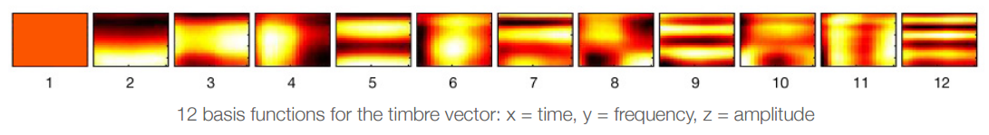
So, mp3s?
Metadata and Audio Features
Sample song [link]
All scraped/analyzed using Echo Nest API
Notes:
NOT AUDIO – metadata and audio features
Take a look at sample
Features to point out:
Expected (artist, title, duration, id's, etc)
Segments (loudness, timbre, pitch)
Key, Danceability, Fade in time
All originally gotten through Echo Nest API
(More later)

Slide 7

Machine Learning Overview
Python module scikit-learn
Supervised learning
Feature and target vectors
Hyperspace
“line”
http://img2.wikia.nocookie.net/__cb20130312014242/starwars/images/a/ae/Hyperspace_falcon.png
Notes:
Reason why here
General overview – not an expert!
Using scikit-learn
Supervised vs. Unsupervised learning
Why this is supervised
Feature and target vectors
Features are “axes”
Using about 140 features
Attempts to extract data from this using a “line”
Dividing up into sections to classify
Regresssion, etc

Slide 8
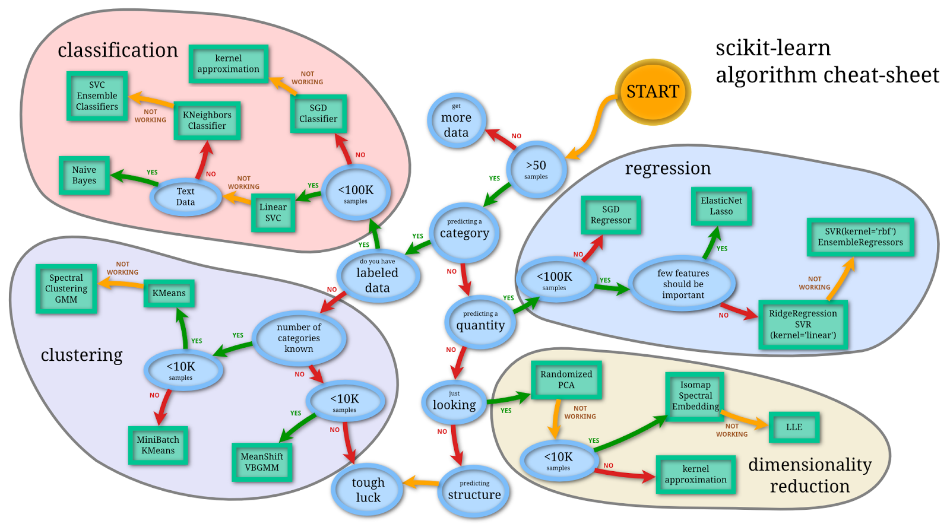
Choosing a Model
http://scikit-learn.org/stable/tutorial/machine_learning_map/
Notes:
Flowchart provided by scikit in order to choose “kernel” of the machine learning
Walk along path -> regresssion ->SVR/Lasso

Slide 9
Model Eval
Regression style model
  Lasso – few important features
Test/train split
Performance
  Avg years off = 7.67yrs
Notes:
Ended up going with Lasso kernel
Various parameters on how the training occurs
Could be computerized, but hand tuned
Machine learning test/train split to prevent data peeking
Performance

Slide 10
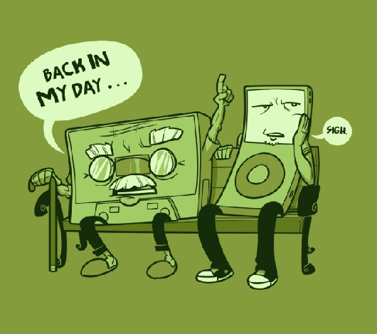
Doesn't Like Oldies
https://media.licdn.com/mpr/mpr/p/1/005/07a/09b/06d2cda.jpg
Notes:
The model doesn't like older songs
Data clustering around the late 90's early 00's
Outliers
Not guess any earlier than 80's (probably a pretty good strategy)
Model persistence through pickling – doesn't need to be gen every time

Slide 11

Server Backend
Cherrypy
  http://localhost:8080/<method>
Dynamic HTML generation
Python “smarts” to populate
Turn steps:
  Get guess
  Generate preview
  Return HTML
http://www.cherrypy.org/images/cherrypy.png
Notes:
Now that we have a guesser need some sort of way for user interaction
Cherrypy – webserver “stack”
Create a localhost connection
http://localhost:8080/method?parm&parm&...
HTML is dynamically generated by python control logic
Explain steps for a game turn

Slide 12
Game Flow
Launcher
(User id + Difficulty)
(Custom parameters)
Game Turn
(guess + id)
Score
End
(User id + Difficulty)
Notes:
KISS - Simple
Higlight how things are passed
Form in game turn -> url w/score
compGuess/etc passed in a “session”
Score updates databases, form for another turn vs end

Slide 13

Song Previews
Echo Nest – Project Rosetta Stone
Links Echo Nest ID's to Spotify ID's
Combination of both APIs = preview
http://www.macobserver.com/imgs/teaser_images/20140307spotify_echo.jpg
Notes:
More challenging pieces of frontend
Using echonest song_id (in database) can convert or search for song on spotify, which has a preview

Slide 14

Launcher
PyQt4
Profile management
  Passwords – bcrypt
Leaderboard
Difficulty Selection
URL generation – webpage launcher
Notes:
Frontend built, so some sort of launcher
(don't want people to create urls by hand)
PyQt4
Profile management
Passwords securely hashed
Blowfish stream cypher
Large salt & variable rounds
Recovery via email
New & load users
Leaderboards
At least 5 games to be in leaderboard
Start – generate the URL, and launch in webbrowser

Slide 15
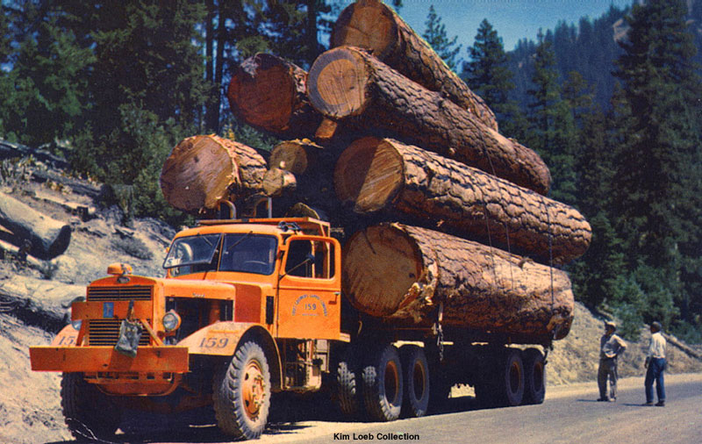
Logging & Testing
Python logging library
“Main method” for testing
http://www.hankstruckpictures.com/pix/trucks/loeb/postcards/mack_lmsw_l_logging_truck.jpg
Notes:
Logging – used logger builtin
Debug and info levels
Both to a rotating log file & stderr
Tests – basic unit tests
If __name__==”__main__”:
Machine learner, gui, previews were main things tested.
Feature testing?

Slide 16
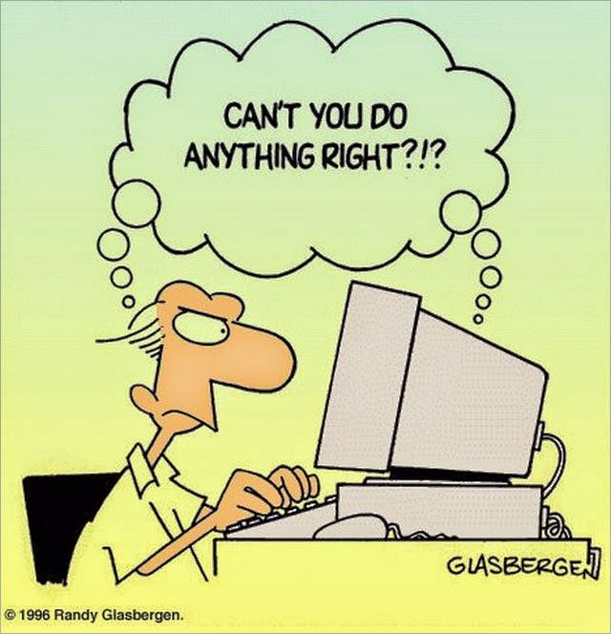
Problems
Cheating Vectors
  Refreshing
  Back
  Plaintext usernames in URL
7digital
Irregular vector sizes
  Variance in 10 “chunks”
Notes:
Of course, never goes completely perfect
Not bulletproof
Refreshing – update score every time
Random “session id” string
Back – update your score based on known info
Javascript to redirect immediately
Plaintext users – change the score of whoever
Obusified with random user id
Previews with 7 digital
Id's in dataset, just couldn't get it to work
Timbre
Each song has different size vector (12 x s)
Split into 10 chunks and get variance

Slide 17
Extension
Using full dataset – improved accuracy?
More features
  Key
  Tempo
  Time signature
Further tuning of machine learning
Notes:
Full dataset – hopefully fix the old song problem
300GB
Couldn't do on my machine
More features
More info lead to better accuracy?
Using computer to optimize parameters
Grid search
Random search

Slide 18
Credits
Bryan DiLaura
Million song Dataset:
Thierry Bertin-Mahieux, Daniel P.W. Ellis, Brian Whitman, and Paul Lamere. The Million Song Dataset. In Proceedings of the 12th International Society for Music Information Retrieval Conference (ISMIR 2011), 2011.
Paul Lamere (spotipy and pyen)
  http://MusicMachinery.com
Notes:
Thanks to Million song dataset
Paul Lamere
Spotipy and pyen

Slide 19
Questions?
Notes:
Any questions?

Slide 20
Thanks!

